Slide 1

VASIREDDY VENKATADRI INSTITUTE OF TECHNOLOGY (Autonomous) Department of Computer Science and Engineering
IV B.Tech -II Semester
Distributed Systems
Unit-V
Distributed File Systems - Coordination and Agreement

Slide 2
UNIT-V: Syllabus
Distributed File Systems: Introduction
File Service Architecture
Peer-to-Peer Systems: Introduction
Napster and its Legacy
Peer-to-Peer Middleware
Routing Overlays.
Coordination and Agreement: Introduction
Distributed Mutual Exclusion
Elections
Multicast Communication.

Slide 3
Distributed File Systems : Introduction
We identified the sharing of resources as a key goal for distributed systems.
The sharing of stored information is perhaps the most important aspect of distributed resource sharing.
Web servers provide a restricted form of data sharing in which files stored locally, in file systems at the server or in servers on a local network, are made available to clients throughout the Internet.
The architecture and implementation of these basic distributed file systems.

Slide 4
The design of large-scale wide area read-write file storage systems poses problems of load balancing, reliability, availability and security.
File systems were originally developed for centralized computer systems and desktop computers as an operating system facility providing a convenient programming interface to disk storage.
They subsequently acquired features such as access-control and file-locking mechanisms that made them useful for the sharing of data and programs.

Slide 5
Distributed file systems support the sharing of information in the form of files and hardware resources in the form of persistent storage throughout an intranet.
A well designed file service provides access to files stored at a server with performance and reliability similar to, and in some cases better than, files stored on local disks.
A file service enables programs to store and access remote files exactly as they do local ones, allowing users to access their files from any computer in an intranet.

Slide 6
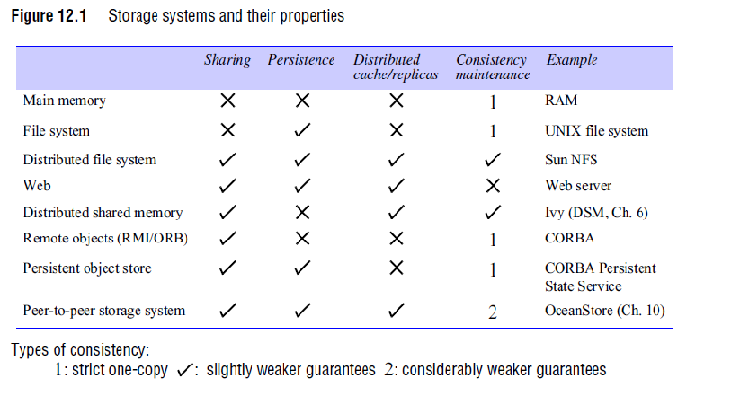

Slide 7
The Figure provides an overview of types of storage system. In addition to those already mentioned, the table includes distributed shared memory (DSM) systems and persistent object stores.
The consistency column indicates whether mechanisms exist for the maintenance of consistency between multiple copies of data when updates occur.
Virtually all storage systems rely on the use of caching to optimize the performance of programs.
Caching was first applied to main memory and non-distributed file systems, and for those the consistency is strict (denoted by a ‘1’, for one-copy consistency in Figure ) .
Programs cannot observe any discrepancies between cached copies and stored data after an update.

Slide 8
Characteristics of file systems:
File systems are responsible for the organization, storage, retrieval, naming, sharing and protection of files.
They provide a programming interface that characterizes the file abstraction, freeing programmers from concern with the details of storage allocation and layout.
Files are stored on disks or other non-volatile storage media.
Files contain both data and attributes. The data consist of a sequence of data items (typically 8-bit bytes), accessible by operations to read and write any portion of the sequence.

Slide 9
The attributes are held as a single record containing information such as the length of the file, timestamps, file type, owner’s identity and access control lists.
A typical attribute record structure is illustrated in Figure.
The shaded attributes are managed by the file system and are not normally updatable by user programs.
File systems are designed to store and manage large numbers of files, with facilities for creating, naming and deleting files.

Slide 10
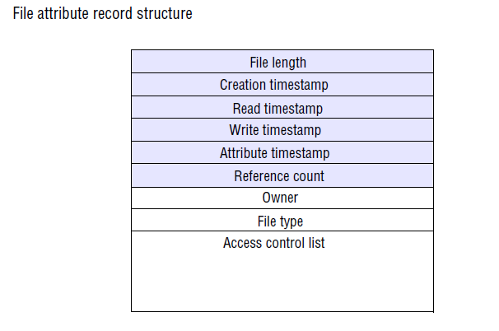

Slide 11
A directory is a file, often of a special type, that provides a mapping from text names to internal file identifiers.
Directories may include the names of other directories, leading to the familiar hierarchic file-naming scheme and the multi-part pathnames for files used in UNIX and other operating systems.
File systems also take responsibility for the control of access to files, restricting access to files according to users’ authorizations and the type of access requested (reading, updating, executing and so on).

Slide 12
The term metadata is often used to refer to all of the extra information stored by a file system that is needed for the management of files.
It includes file attributes, directories and all the other persistent information used by the file system.

Slide 13
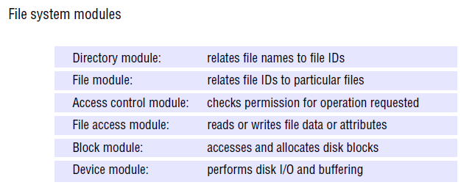

Slide 14
File system operations:
The Figure summarizes the main operations on files that are available to applications in UNIX systems.
These are the system calls implemented by the kernel; application programmers usually access them through procedure libraries such as the C Standard Input/Output Library or the Java file classes.

Slide 15
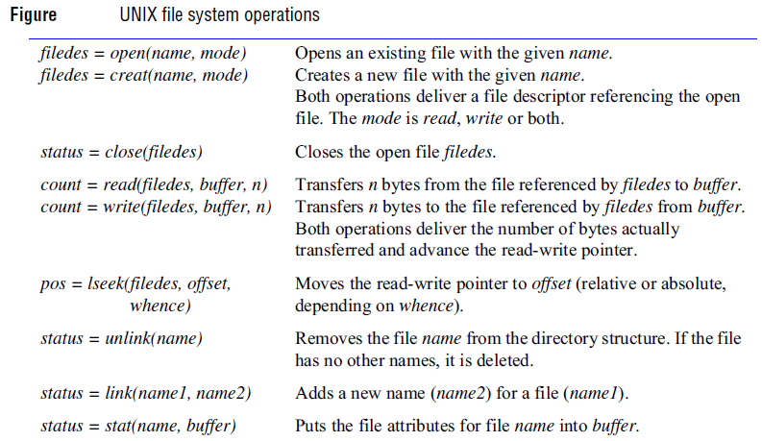

Slide 16
The UNIX operations are based on a programming model in which some file state information is stored by the file system for each running program.
This consists of a list of currently open files with a read-write pointer for each, giving the position within the file at which the next read or write operation will be applied.
The file system is responsible for applying access control for files. In local file systems such as UNIX, it does so when each file is opened, checking the rights allowed for the user’s identity in the access control list against the mode of access requested in the open system call.
If the rights match the mode, the file is opened and the mode is recorded in the open file state information.

Slide 17
Distributed file system requirements
They offer access transparency and location transparency; performance, scalability, concurrency control, fault tolerance and security requirements emerged and were met in subsequent phases of development.
We discuss these and related requirements in the following subsections.

Slide 18
Transparency
The file service is usually the most heavily loaded service in an intranet, so its functionality and performance are critical.
The design of the file service should support many of the transparency requirements for distributed systems.
The design must balance the flexibility and scalability that derive from transparency against software complexity and performance.
The following forms of transparency are partially or wholly addressed by current file services.

Slide 19
Access transparency: Client programs should be unaware of the distribution of files.
A single set of operations is provided for access to local and remote files.
Programs written to operate on local files are able to access remote files without modification.
Location transparency: Client programs should see a uniform file name space.
Files or groups of files may be relocated without changing their pathnames, and user programs see the same name space wherever they are executed.

Slide 20
Mobility transparency: Neither client programs nor system administration tables in client nodes need to be changed when files are moved.
This allows file mobility – files or, more commonly, sets or volumes of files may be moved, either by system administrators or automatically.
Performance transparency: Client programs should continue to perform satisfactorily while the load on the service varies within a specified range.
Scaling transparency: The service can be expanded by incremental growth to deal with a wide range of loads and network sizes.

Slide 21
Concurrent file updates:
Changes to a file by one client should not interfere with the operation of other clients simultaneously accessing or changing the same file. This is the well-known issue of concurrency control.
The need for concurrency control for access to shared data in many applications is widely accepted and techniques are known for its implementation, but they are costly.

Slide 22
File replication:
In a file service that supports replication, a file may be represented by several copies of its contents at different locations.
This has two benefits – it enables multiple servers to share the load of providing a service to clients accessing the same set of files, enhancing the scalability of the service, and it enhances fault tolerance by enabling clients to locate another server that holds a copy of the file when one has failed.

Slide 23
Hardware and operating system heterogeneity :
The service interfaces should be defined so that client and server software can be implemented for different operating systems and computers. This requirement is an important aspect of openness.

Slide 24
Fault tolerance:
The central role of the file service in distributed systems makes it essential that the service continue to operate in the face of client and server failures.
The servers can be stateless, so that they can be restarted and the service restored after a failure without any need to recover previous state.
Tolerance of disconnection or server failures requires file replication, which is more difficult to achieve.

Slide 25
Consistency:
Conventional file systems such as that provided in UNIX offer one-copy update semantics.
This refers to a model for concurrent access to files in which the file contents seen by all of the processes accessing or updating a given file are those that they would see if only a single copy of the file contents existed.

Slide 26
Security:
Virtually all file systems provide access-control mechanisms based on the use of access control lists.
In distributed file systems, there is a need to authenticate client requests so that access control at the server is based on correct user identities and to protect the contents of request and reply messages with digital signatures and (optionally) encryption of secret data.

Slide 27
Efficiency:
A distributed file service should offer facilities that are of at least the same power and generality as those found in conventional file systems and should achieve a comparable level of performance.
The techniques used for the implementation of file services are an important part of the design of distributed systems.
A distributed file system should provide a service that is comparable with, or better than, local file systems in performance and reliability.
It must be convenient to administer, providing operations and tools that enable system administrators to install and operate the system conveniently.

Slide 28
File service architecture
An architecture that offers a clear separation of the main concerns in providing access to files is obtained by structuring the file service as three components – a flat file service, a directory service and a client module.
The relevant modules and their relationships are shown in Figure.
The flat file service and the directory service each export an interface for use by client programs, and their RPC interfaces, taken together, provide a comprehensive set of operations for access to files.

Slide 29
The client module provides a single programming interface with operations on files similar to those found in conventional file systems.
The design is open in the sense that different client modules can be used to implement different programming interfaces, simulating the file operations of a variety of different operating systems and optimizing the performance for different client and server hardware configurations.

Slide 30
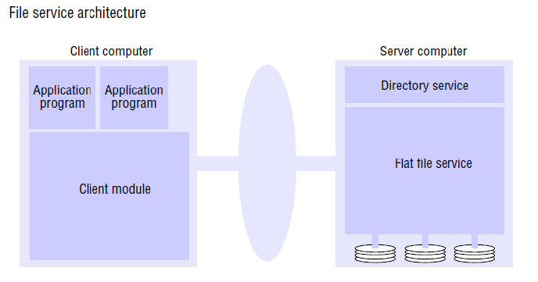

Slide 31
Flat file service:
The flat file service is concerned with implementing operations on the contents of files.
Unique file identifiers (UFIDs) are used to refer to files in all requests for flat file service operations.
The division of responsibilities between the file service and the directory service is based upon the use of UFIDs.
UFIDs are long sequences of bits chosen so that each file has a UFID that is unique among all of the files in a distributed system.
When the flat file service receives a request to create a file, it generates a new UFID for it and returns the UFID to the requester.

Slide 32
Directory service:
The directory service provides a mapping between text names for files and their UFIDs.
Clients may obtain the UFID of a file by quoting its text name to the directory service.
The directory service provides the functions needed to generate directories, to add new file names to directories and to obtain UFIDs from directories.
When a hierarchic file-naming scheme is adopted, as in UNIX, directories hold references to other directories.

Slide 33
Client module:
A client module runs in each client computer, integrating and extending the operations of the flat file service and the directory service under a single application programming interface that is available to user-level programs in client computers.
The client module also holds information about the network locations of the flat file server and directory server processes.
Finally, the client module can play an important role in achieving satisfactory performance through the implementation of a cache of recently used file blocks at the client.

Slide 34
Flat file service interface:
This is the RPC interface used by client modules.
It is not normally used directly by user-level programs.
A FileId is invalid if the file that it refers to is not present in the server processing the request or if its access permissions are inappropriate for the operation requested.
All of the procedures in the interface except Create throw exceptions if the FileId argument contains an invalid UFID or the user doesn’t have sufficient access rights.

Slide 35
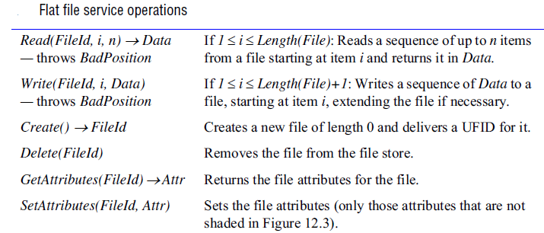

Slide 36
The most important operations are those for reading and writing.
Both the Read and the Write operation require a parameter i specifying a position in the file.
The Read operation copies the sequence of n data items beginning at item i from the specified file into Data, which is then returned to the client.
The Write operation copies the sequence of data items in Data into the specified file beginning at item i, replacing the previous contents of the file at the corresponding position and extending the file if necessary.

Slide 37
Create creates a new, empty file and returns the UFID that is generated.
Delete removes the specified file.
GetAttributes and SetAttributes enable clients to access the attribute record.
GetAttributes is normally available to any client that is allowed to read the file.
Access to the SetAttributes operation would normally be restricted to the directory service that provides access to the file.

Slide 38
Access control:
In the UNIX file system, the user’s access rights are checked against the access mode (read or write) requested in the open call and the file is opened only if the user has the necessary rights.
The user identity (UID) used in the access rights check is retrieved during the user’s earlier authenticated login and cannot be tampered with in non-distributed implementations.
The resulting access rights are retained until the file is closed, and no further checks are required when subsequent operations on the same file are requested.

Slide 39
In distributed implementations, access rights checks have to be performed at the server because the server RPC interface is an otherwise unprotected point of access to files.
A user identity has to be passed with requests, and the server is vulnerable to forged identities.

Slide 40
Directory service interface:
The Figure contains a definition of the RPC interface to a directory service.
The primary purpose of the directory service is to provide a service for translating text names to UFIDs.
In order to do so, it maintains directory files containing the mappings between text names for files and UFIDs.
Each directory is stored as a conventional file with a UFID, so the directory service is a client of the file service.

Slide 41
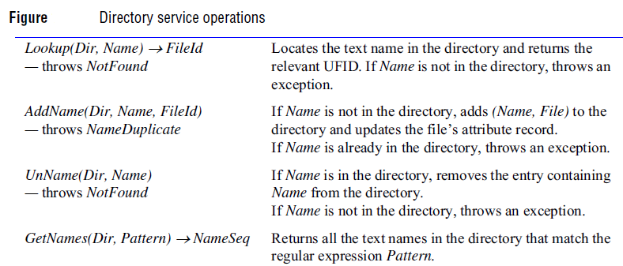

Slide 42
File groups:
A file group is a collection of files located on a given server.
A server may hold several file groups, and groups can be moved between servers, but a file cannot change the group to which it belongs.
A similar construct called a file system is used in UNIX and in most other operating systems.
In a distributed file service, file groups support the allocation of files to file servers in larger logical units and enable the service to be implemented with files stored on several servers.

Slide 43
In a distributed file system that supports file groups, the representation of UFIDs includes a file group identifier component, enabling the client module in each client computer to take responsibility for dispatching requests to the server that holds the relevant file group.
File group identifiers must be unique throughout a distributed system.
Since file groups can be moved and distributed systems that are initially separate can be merged to form a single system, the only way to ensure that file group identifiers will always be distinct in a given system is to generate them with an algorithm that ensures global uniqueness.

Slide 44

For example, whenever a new file group is created, a unique identifier can be generated by concatenating the 32-bit IP address of the host creating the new group with a 16-bit integer derived from the date, producing a unique 48-bit integer.

Slide 45
Peer-to-Peer Systems: Introduction
The goal of peer-to-peer systems is to enable the sharing of data and resources on a very large scale by eliminating any requirement for separately managed servers and their associated infrastructure.
Peer-to-peer systems aim to support useful distributed services and applications using data and computing resources available in the personal computers and workstations that are present in the Internet and other networks in ever-increasing numbers.

Slide 46
Traditional client-server systems manage and provide access to resources such as files, web pages or other information objects located on a single server computer or a small cluster of tightly coupled servers.
Peer-to-peer systems provide access to information resources located on computers throughout a network.
Algorithms for the placement and subsequent retrieval of information objects are a key aspect of the system design.
The aim is to deliver a service that is fully decentralized and self-organizing, dynamically balancing the storage and processing loads between all the participating computers as computers join and leave the service.

Slide 47
Peer-to-peer systems share these characteristics:
• Their design ensures that each user contributes resources to the system.
• Although they may differ in the resources that they contribute, all the nodes in a peer-to-peer system have the same functional capabilities and responsibilities.
• Their correct operation does not depend on the existence of any centrally administered systems.
• A key issue for their efficient operation is the choice of an algorithm for the placement of data across many hosts and subsequent access to it in a manner that balances the workload and ensures availability without adding undue overheads.

Slide 48
Peer-to-peer services therefore cannot rely on guaranteed access to individual resources, although they can be designed to make the probability of failure to access a copy of a replicated object arbitrarily small.

Slide 49
Peer-to-peer middleware
The third generation is characterized by the emergence of middleware layers for the application -independent management of distributed resources on a global scale.
Several research teams have now completed the development, evaluation and refinement of peer-to-peer middleware platforms and demonstrated or deployed them in a range of application services.

Slide 50
These platforms are designed to place resources (data objects, files) on a set of computers that are widely distributed throughout the Internet.
To route messages to them on behalf of clients, relieving clients of any need to make decisions about placing resources and to hold information about the whereabouts of the resources they require.
They provide guarantees of delivery for requests in a bounded number of network hops.
They place replicas of resources on available host computers in a structured manner, taking account of their volatile availability, their variable trustworthiness and requirements for load balancing and locality of information storage and use.

Slide 51
Resources are identified by globally unique identifiers (GUIDs), usually derived as a secure hash from some or all of the resource’s state.
The use of a secure hash makes a resource ‘self certifying’ – clients receiving a resource can check the validity of the hash.
This protects it against tampering by untrusted nodes on which it may be stored, but this technique requires that the states of resources are immutable, since a change to the state would result in a different hash value.
Hence peer-to- peer storage systems are inherently best suited to the storage of immutable objects(such as music or video files).

Slide 52
Overlay routing versus IP routing :
At first sight, routing overlays share many characteristics with the IP packet routing infrastructure that constitutes the primary communication mechanism of the Internet .
An additional application-level routing mechanism is required in peer-to-peer systems.

Slide 53
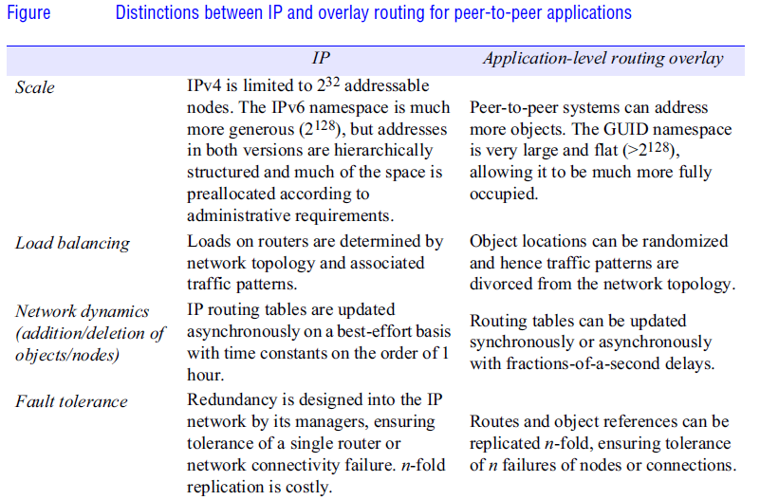

Slide 54
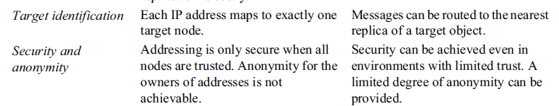

Slide 55
Napster and its legacy
The first application in which a demand for a globally scalable information storage and retrieval service emerged was the downloading of digital music files.
Both the need for and the feasibility of a peer-to-peer solution were first demonstrated by the Napster files sharing system which provided a means for users to share files.

Slide 56
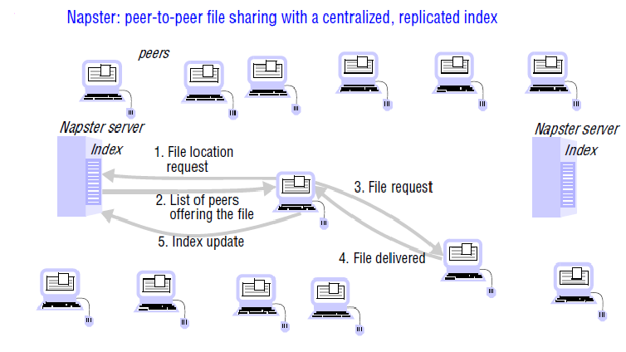

Slide 57
Napster’s architecture included centralized indexes, but users supplied the files, which were stored and accessed on their personal computers.
Napster’s method of operation is illustrated by the sequence of steps shown in Figure.
In step 5 clients are expected to add their own music files to the pool of shared resources by transmitting a link to the Napster indexing service for each available file.
The motivation for Napster and the key to its success was the making available of a large, widely distributed set of files to users throughout the Internet.

Slide 58
Due to lack of outstanding of the receivers and the providers of shared data and other resources is a concern for the designers of peer-to-peer systems.
In systems with many nodes, the routing of requests and results can be made sufficiently tortuous to conceal their source and the contents of files can be distributed across multiple nodes, spreading the responsibility for making them available.

Slide 59
Mechanisms for anonymous communication that are resistant to most forms of traffic analysis are available .
If files are also encrypted before they are placed on servers, the owners of the servers can plausibly deny any knowledge of the contents.
But these anonymity techniques add to the cost of resource sharing, and recent work has shown that the anonymity available is weak against some attacks.

Slide 60
Lessons learned from Napster:
Napster demonstrated the feasibility of building a useful large-scale service that depends almost wholly on data and computers owned by ordinary Internet users.
To avoid swamping(overwhelm) the computing resources of individual users (for example, the first user to offer a chart-topping song) and their network connections, Napster took account of network locality – the number of hops between the client and the server
when allocating a server to a client requesting a song. This simple load distribution mechanism enabled the service to scale to meet the needs of large numbers of users.

Slide 61
Limitations:
Napster used a (replicated) unified index of all available music files.
For the application in question, the requirement for consistency between the replicas was not strong, so this did not hamper performance, but for many applications it would constitute a limitation.
Unless the access path to the data objects is distributed, object discovery and addressing are likely to become a bottleneck.

Slide 62
Application dependencies: Napster took advantage of the special characteristics of the application for which it was designed in other ways:
Music files are never updated, avoiding any need to make sure all the replicas of files remain consistent after updates.
No guarantees are required concerning the availability of individual files – if a music file is temporarily unavailable, it can be downloaded later.
This reduces the requirement for dependability of individual computers and their connections to the Internet.

Slide 63
Peer-to-Peer Middleware
A key problem in the design of peer-to-peer applications is providing a mechanism to enable clients to access data resources quickly and dependably wherever they are located throughout the network.
Peer-to-peer middleware systems are designed specifically to meet the need for the automatic placement and subsequent location of the distributed objects managed by peer-to-peer systems and applications.

Slide 64
Functional requirements:
The function of peer-to-peer middleware is to simplify the construction of services that are implemented across many hosts in a widely distributed network.
To achieve this it must enable clients to locate and communicate with any individual resource made available to a service, even though the resources are widely distributed amongst the hosts.
Other important requirements include the ability to add new resources and to remove them at will and to add hosts to the service and remove them.
peer-to-peer middleware should offer a simple programming interface to application programmers that is independent of the types of distributed resource that the application manipulates.

Slide 65
Non-functional requirements:
To perform effectively, peer-to-peer middleware must also address the following non-functional requirements :
Global scalability: One of the aims of peer-to-peer applications is to exploit the hardware resources of very large numbers of hosts connected to the Internet.
Peer-to-peer middleware must therefore be designed to support applications that access millions of objects on tens of thousands or hundreds of thousands of hosts.

Slide 66
Load balancing:
The performance of any system designed to exploit a large number of computers depends upon the balanced distribution of workload across them.
For the systems we are considering, this will be achieved by a random placement of resources together with the use of replicas of heavily used resources.

Slide 67
Optimization for local interactions between neighbouring peers:
The ‘network distance’ between nodes that interact has a substantial impact on the latency of individual interactions, such as client requests for access to resources.
Network traffic loadings are also impacted by it. The middleware should aim to place resources close to the nodes that access them the most.

Slide 68
Accommodating to highly dynamic host availability:
Most peer-to-peer systems are constructed from host computers that are free to join or leave the system at any time.
The hosts and network segments used in peer-to-peer systems are not owned or managed by any single authority; neither their reliability nor their continuous participation in the provision of a service is guaranteed.
As hosts join the system, they must be integrated into the system and the load must be redistributed to exploit their resources.
When they leave the system whether voluntarily or involuntarily, the system must detect their departure and redistribute their load and resources.

Slide 69
Security of data in an environment with heterogeneous trust:
In global-scale systems with participating hosts of diverse ownership, trust must be built up by the use of authentication and encryption mechanisms to ensure the integrity and privacy of information.

Slide 70
Anonymity, deniability and resistance to censorship:
The anonymity for the holders and recipients of data is a legitimate concern in many situations demanding resistance to censorship.
A related requirement is that the hosts that hold data should be able to plausibly deny responsibility for holding or supplying it.
The use of large numbers of hosts in peer-to-peer systems can be helpful in achieving these properties.

Slide 71
The requirements for scalability and availability make it infeasible to maintain a database at all client nodes giving the locations of all the resources (objects) of interest.
Knowledge of the locations of objects must be partitioned and distributed throughout the network.
Each node is made responsible for maintaining detailed knowledge of the locations of nodes and objects in a portion of the namespace as well as a general knowledge of the topology of the entire namespace (Figure ).
A high degree of replication of this knowledge is necessary to ensure dependability in the face of the volatile availability of hosts and intermittent network connectivity.

Slide 72
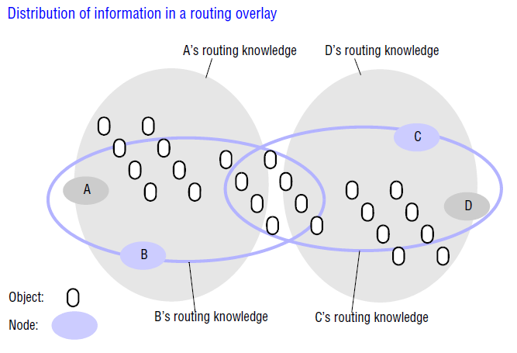

Slide 73
Routing overlays
In peer-to-peer systems a distributed algorithm known as a routing overlay takes responsibility for locating nodes and objects.
The name denotes the fact that the middleware takes the form of a layer that is responsible for routing requests from any client to a host that holds the object to which the request is addressed.
The objects of interest may be placed at and subsequently relocated to any node in the network without client involvement.

Slide 74
It is termed an overlay since it implements a routing mechanism in the application layer that is quite separate from any other routing mechanisms deployed at the network level such as IP routing.
The routing overlay ensures that any node can access any object by routing each request through a sequence of nodes, exploiting knowledge at each of them to locate the destination object.
Peer-to-peer systems usually store multiple replicas of objects to ensure availability.
In that case, the routing overlay maintains knowledge of the location of all the available replicas and delivers requests to the nearest ‘live’ node (i.e. one that has not failed) that has a copy of the relevant object.

Slide 75
The main task of a routing overlay is the following:
Routing of requests to objects:
A client wishing to invoke an operation on an object submits a request including the object’s GUID to the routing overlay, which routes the request to a node at which a replica of the object resides.
But the routing overlay must also perform some other tasks:
Insertion of objects: A node wishing to make a new object available to a peer-to-peer service computes a GUID for the object and announces it to the routing overlay, which then ensures that the object is reachable by all other clients.
Deletion of objects: When clients request the removal of objects from the service the routing overlay must make them unavailable.

Slide 76
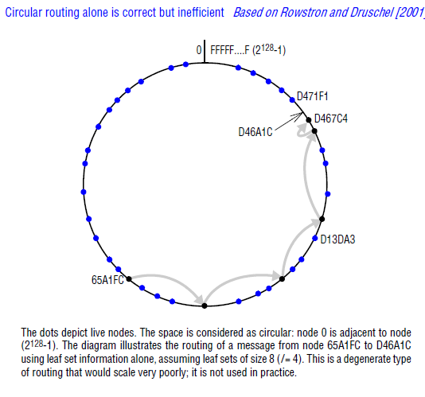

Slide 77
Node addition and removal:
Nodes (i.e., computers) may join and leave the service.
When a node joins the service, the routing overlay arranges for it to assume some of the responsibilities of other nodes.
When a node leaves (either voluntarily or as a result of a system or network fault), its responsibilities are distributed amongst the other nodes.

Slide 78
An object’s GUID is computed from all or part of the state of the object using a function that delivers a value that is, with very high probability, unique.
Uniqueness is verified by searching for another object with the same GUID.
A hash function (such as SHA-1) is used to generate the GUID from the object’s value.
Because these randomly distributed identifiers are used to determine the placement of objects and to retrieve them, overlay routing systems are sometimes described as distributed hash tables (DHT).

Slide 79
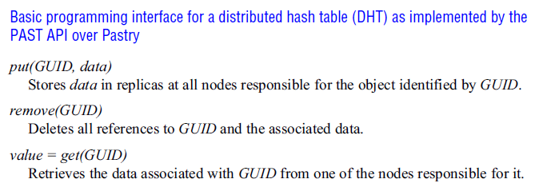
The put() operation is used to submit a data item to be stored together with its GUID.
The DHT layer takes responsibility for choosing a location for it, storing it (with replicas to ensure availability) and providing access to it via the get() operation.

Slide 80
A slightly more flexible form of API is provided by a distributed object location and routing (DOLR) layer, as shown in Figure .
With this interface objects can be stored anywhere and the DOLR layer is responsible for maintaining a mapping between object identifiers (GUIDs) and the addresses of the nodes at which replicas of the objects are located.
Objects may be replicated and stored with the same GUID at different hosts, and the routing overlay takes responsibility for routing requests to the nearest available replica.

Slide 81
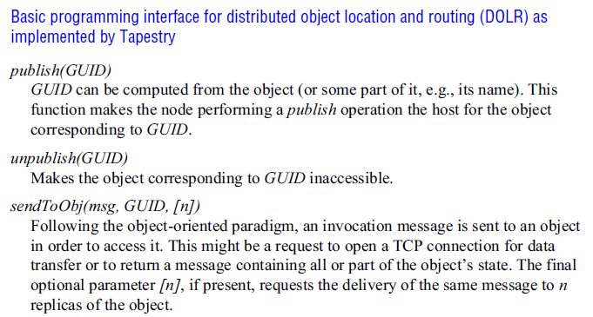

Slide 82
With the DHT model, a data item with GUID X is stored at the node whose GUID is numerically closest to X and at the r hosts whose GUIDs are next-closest to it numerically, where r is a replication factor chosen to ensure a very high probability of availability.
With the DOLR model, locations for the replicas of data objects are decided outside the routing layer and the DOLR layer is notified of the host address of each replica using the publish() operation.

Slide 83
The interfaces in previous Figures 1 and 2 are based on a set of abstract representations to show that most peer-to-peer routing overlay implementations developed to date provide very similar functionality.
The evaluations demonstrated that their performance and dependability were adequate for use in many production environments. In the next section we describe two of these in detail.
Pastry, which implements a distributed hash table API similar to the one presented in Figure 1, and Tapestry, which implements an API similar to that shown in Figure 2.
Both Pastry and Tapestry employ a routing mechanism known as prefix routing to determine routes for the delivery of messages based on the values of the GUIDs to which they are addressed.

Slide 84
Both Pastry and Tapestry employ a routing mechanism known as prefix routing to determine routes for the delivery of messages based on the values of the GUIDs to which they are addressed.
Prefix routing narrows the search for the next node along the route by applying a binary mask that selects an increasing number of hexadecimal digits from the destination GUID after each hop.

Slide 85
GUIDs are not human-readable, so client applications must obtain the GUIDs for resources of interest through some form of indexing service using human-readable names or search requests.
Ideally, these indexes are also stored in a peer-to-peer manner to overcome the weaknesses of centralized indexes evidenced by Napster.
In BitTorrent a web index search leads to a stub file containing details of the desired resource, including its
GUID and the URL of a tracker – a host that holds an up-to-date list of network addresses for providers willing to supply the file.

Slide 86
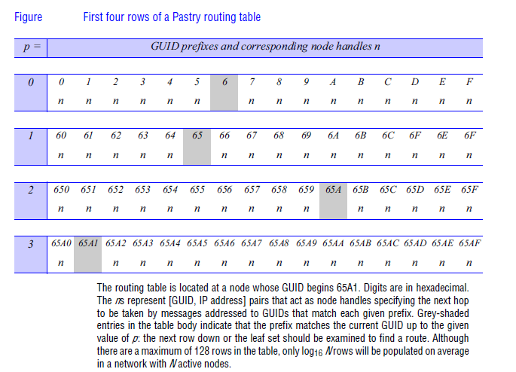

Slide 87
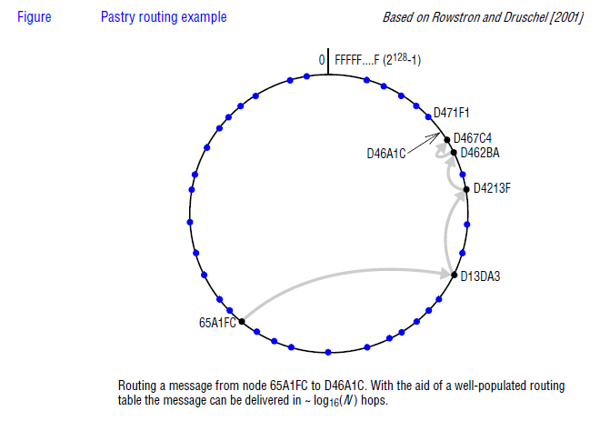

Slide 88
Coordination and Agreement: Introduction

